Slide 1
Deadlocks
Chapter 3
3.1. Resource
3.2. Introduction to deadlocks
3.3. The ostrich algorithm
3.4. Deadlock detection and recovery
3.5. Deadlock avoidance
3.6. Deadlock prevention
3.7. Other issues

Slide 2
Chapter Objectives
To develop a description of deadlocks, which prevent sets of concurrent processes from completing their tasks
To present a number of different methods for preventing or avoiding deadlocks in a computer system.

Slide 3
Resources(1)
Examples of computer resources
printers
tape drives
tables
Processes need access to resources in reasonable order
Suppose a process holds resource X and requests resourceY
at same time another process holds Y and requests X
both are blocked and remain so

Slide 4
Resources (2)
Deadlocks occur when …
processes are granted exclusive access to devices
we refer to these devices generally as resources
Preemptable resources
can be taken away from a process with no ill effects
Nonpreemptable resources
will cause the process to fail if taken away

Slide 5
Resources (3)
Sequence of events required to use a resource
request the resource
use the resource
release the resource
Must wait if request is denied
requesting process may be blocked
may fail with error code

Slide 6
Resources (4)
Example request/release as system call
request/release device
open/close file
allocate/free memory
wait/signal

Slide 7
Introduction to Deadlocks
Formal definition : A set of processes is deadlocked if each process in the set is waiting for an event that only another process in the set can cause
Usually the event is release of a currently held resource
None of the processes can …
run
release resources
be awakened

Slide 8
Four Conditions for Deadlock
Mutual exclusion condition
each resource assigned to 1 process or is available
Hold and wait condition
process holding resources can request additional
No preemption condition
previously granted resources cannot forcibly taken away
Circular wait condition
must be a circular chain of 2 or more processes
each is waiting for resource held by next member of the chain

Slide 9
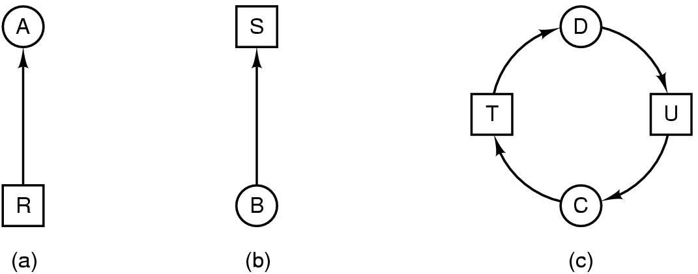
Deadlock Modeling (1)
Modeled with directed graphs
Resource-Allocation Graph (RAG)
resource R assigned to process A
process B is requesting/waiting for resource S
process C and D are in deadlock over resources T and U

Slide 10
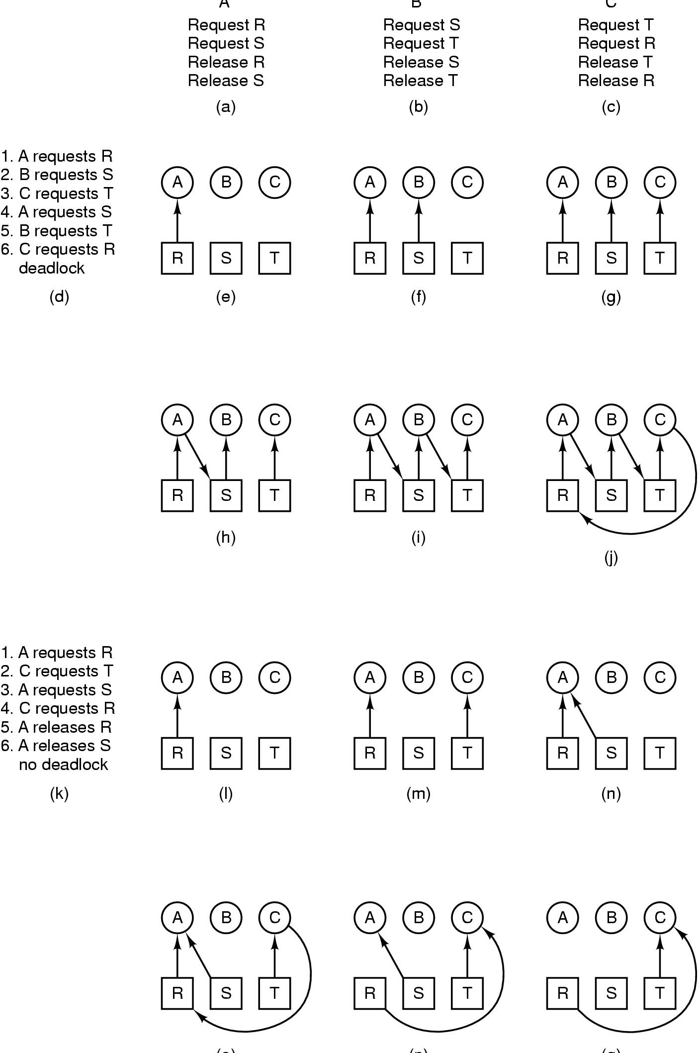
Deadlock Modeling (2)
A B C
How deadlock occurs

Slide 11
Deadlock Modeling (3)
(o) (p) (q)
How deadlock can be avoided

Slide 12
Strategies for dealing with Deadlocks
Just ignore the problem altogether
Detection and recovery
Dynamic avoidance
careful resource allocation
Prevention
negating one of the four necessary conditions

Slide 13
The Ostrich Algorithm
Pretend there is no problem
Reasonable if
deadlocks occur very rarely
cost of prevention is high
UNIX and Windows takes this approach
It is a trade off between
convenience
correctness

Slide 14
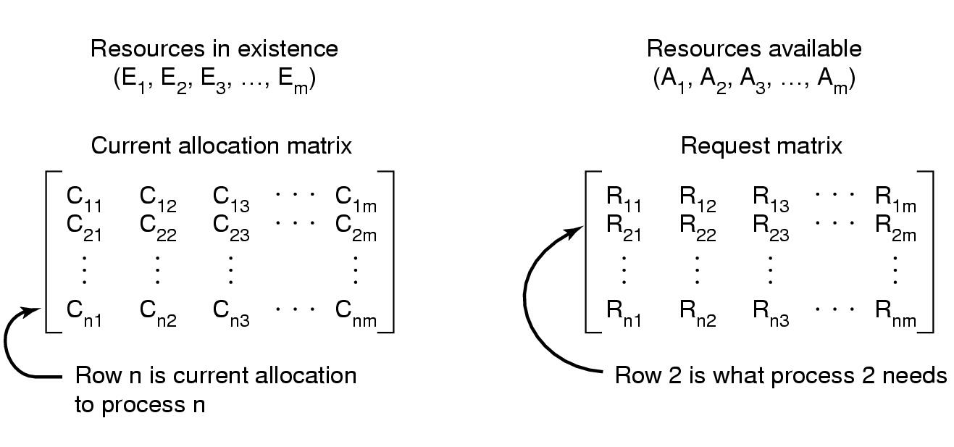
Detection with Multiple Resource of Each Type (1)
Data structures needed by deadlock detection algorithm

Slide 15
Detection with Multiple Resource of Each Type (2)
The deadlock detection algorithm:
Look for unmarked process, P_{i}, for which the
i-th row of R is less than or equal to A
If such process is found, add the i-th row of C to A , mark the process and go back to step 1
If no such process exists, the algorithm terminates.
When algorithm terminates, any unmarked processes
are known to be dealocked

Slide 16
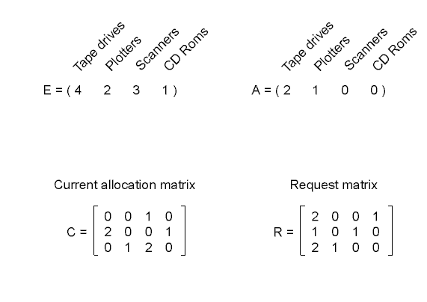
Detection with Multiple Resource of Each Type (3)
An example for the deadlock detection algorithm
After first cycle A=(2 2 2 0),
After second cycle A=(4 2 2 1)
Notes:
4231

Slide 17
Recovery from Deadlock (1)
Recovery through preemption
take a resource from some other process
depends on nature of the resource
Recovery through rollback
checkpoint a process periodically
use this saved state
restart the process if it is found deadlocked

Slide 18
Recovery from Deadlock (2)
Recovery through killing processes
crudest but simplest way to break a deadlock
kill one of the processes in the deadlock cycle
the other processes get its resources
choose process that can be rerun from the beginning

Slide 19
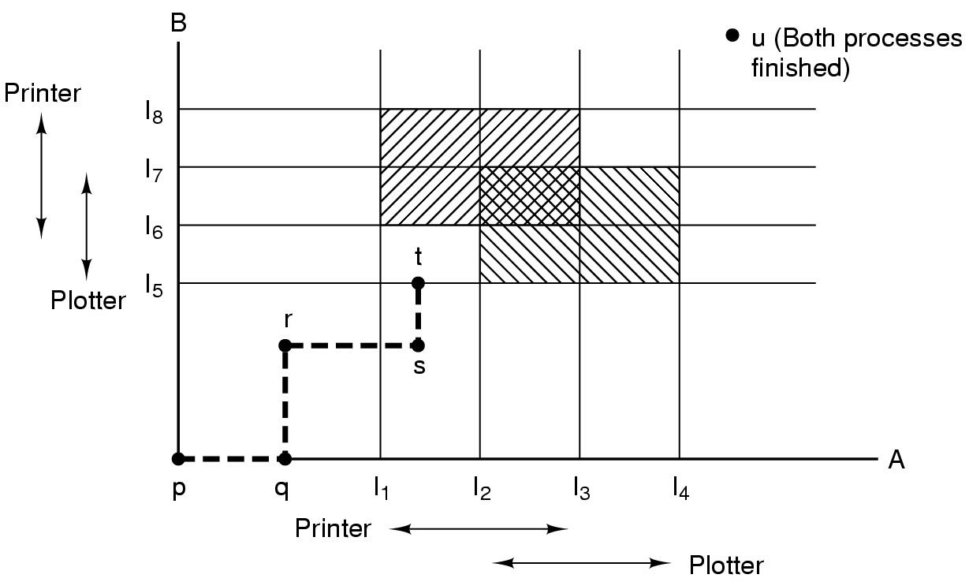
Deadlock Avoidance Resource Trajectories
Two process resource trajectories

Slide 20
Deadlock Avoidance Basic Facts
At any instant of time, current state of system consisting of E (Resources in Existance), A (Resource Available), C (Current allocation matrix), R (Request matrix)
If a system is in safe state ⇒ no deadlocks.
If a system is in unsafe state ⇒ possibility of deadlock.
Avoidance ⇒ ensure that a system will never enter an unsafe state.

Slide 21
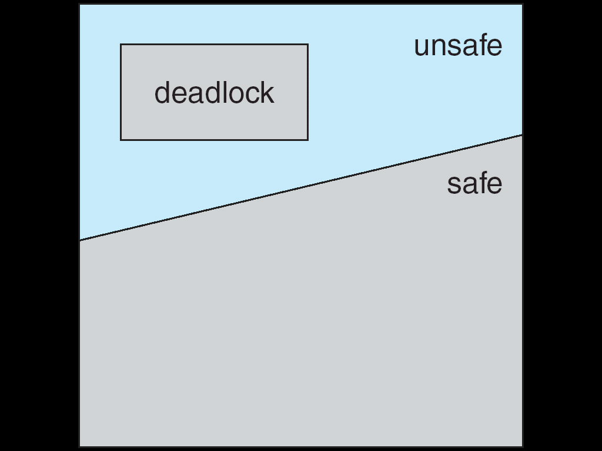
Deadlock Avoidance Safe, Unsafe , Deadlock State

Slide 22
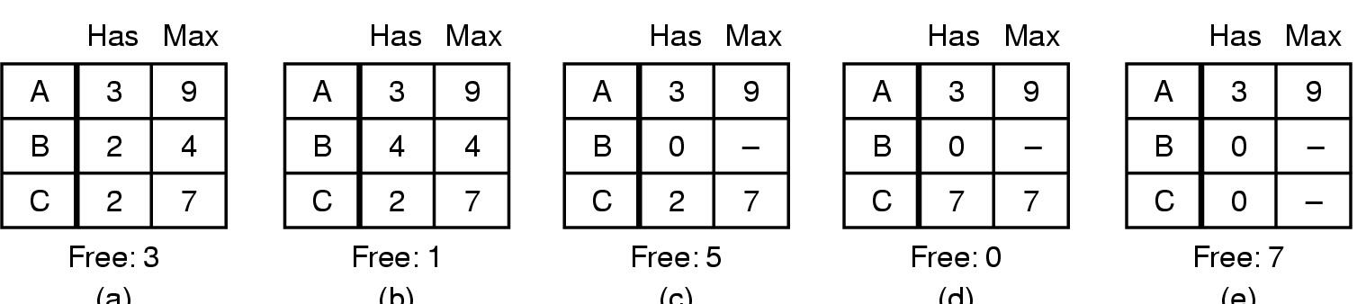
Deadlock Avoidance Safe and Unsafe States (1)
(a) (b) (c) (d) (e)
- Example: 3 processses A, B, C using one resource with total 10 instances, 7 already allocated, 3 available
- Demonstration that the state in (a) is safe

Slide 23
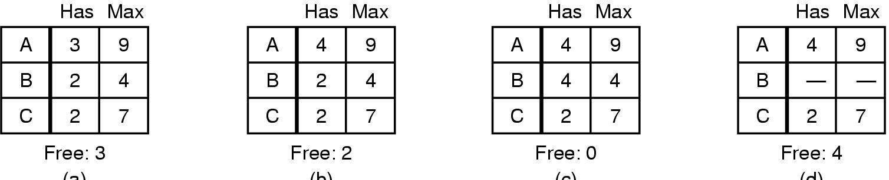
Deadlock Avoidance Safe and Unsafe States (2)
(a) (b) (c) (d)
Demonstration that the state in b is not safe

Slide 24
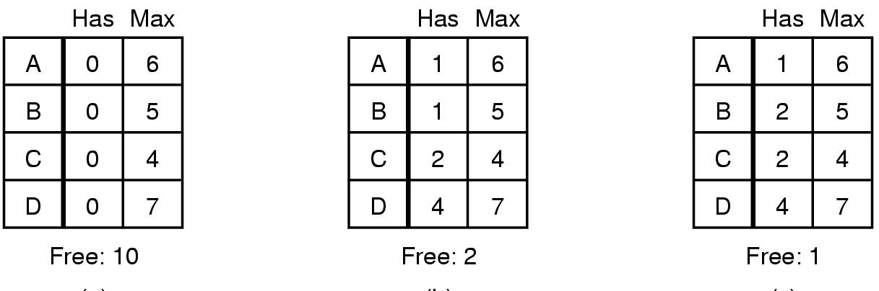
Deadlock Avoidance The Banker's Algorithm for a Single Resource (1)
(a) (b) (c)
Three resource allocation states
(a) safe
(b) safe
(c) unsafe

Slide 25
Deadlock Avoidance The Banker's Algorithm for a Single Resource (2)
The banker’s algorithm considers each request as it occurs, and see if granting it leads to a safe state.
If it does, the request is granted; otherwise, it is postponed until later.
To see if a state is safe, the banker checks to see if he has enough resources to satisfy some customer.
If so, those loans are assumed to be repaid, and the customer now closest to the limit is checked, and so on. If all loans can eventually be repaid, the state is safe and the initial request can be granted.

Slide 26
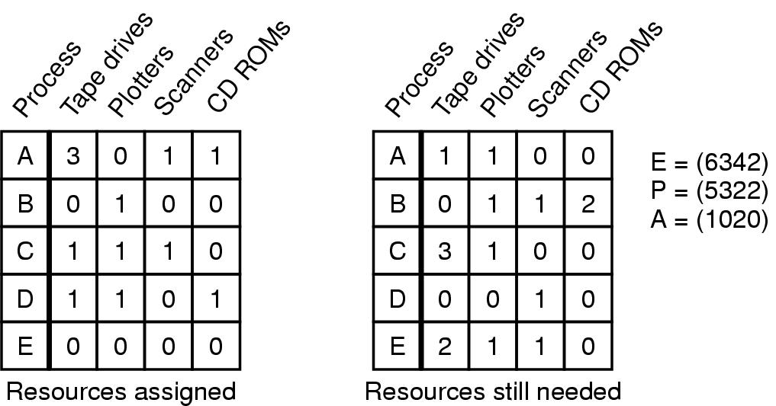
Deadlock Avoidance Banker's Algorithm for Multiple Resources (1)
Example of banker's algorithm with multiple resources
If order is D, E, A, B, C, Vector A will be (2121), (2121), (5132), (5232), (6342)

Slide 27
Deadlock Avoidance Banker's Algorithm for Multiple Resources (2)
The algorithm for checking to see if a state is safe can be stated.
1. Look for a row, R, whose unmet resource needs are all smaller than or equal to A. If no such row exists, the system will eventually deadlock since no process can run to completion.
2. Assume the process of the row chosen requests all the resources it needs and finishes. Mark that process as terminated and add all its resources to the A vector.
3. Repeat steps 1 and 2 until either all processes are marked terminated, in which case the initial state was safe, or until a deadlock occurs, in which case it was not.

Slide 28
Deadlock Prevention Attacking the Mutual Exclusion Condition
Some devices (such as printer) can be spooled
only the printer daemon uses printer resource
thus deadlock for printer eliminated
Not all devices can be spooled
Principle:
avoid assigning resource when not absolutely necessary
as few processes as possible actually claim the resource

Slide 29
Four Conditions for Deadlock
Mutual exclusion condition
each resource assigned to 1 process or is available
Hold and wait condition
process holding resources can request additional
No preemption condition
previously granted resources cannot forcibly taken away
Circular wait condition
must be a circular chain of 2 or more processes
each is waiting for resource held by next member of the chain

Slide 30
Deadlock Prevention Attacking the Hold and Wait Condition
Require processes to request resources before starting
a process never has to wait for what it needs
Problems
may not know required resources at start of run
also ties up resources other processes could be using
Variation:
process must give up all resources
then request all immediately needed

Slide 31
Deadlock Prevention Attacking the No Preemption Condition
This is not a viable option
Consider a process given the printer
halfway through its job
now forcibly take away printer
!!??

Slide 32
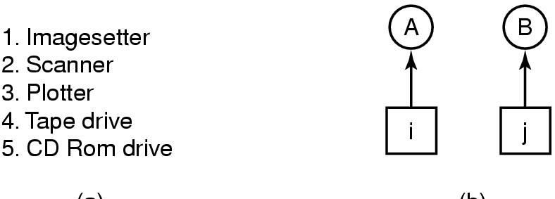
Deadlock Prevention Attacking the Circular Wait Condition (1)
(a) (b)
Normally ordered resources
A resource graph

Slide 33
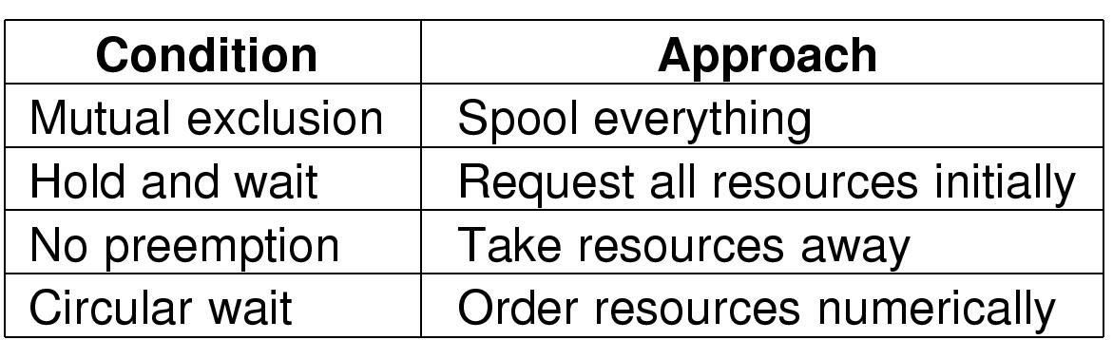
Deadlock Prevention
Summary of approaches to deadlock prevention

Slide 34
Other Issues Two-Phase Locking
Phase One
process tries to lock all records it needs, one at a time
if needed record found locked, start over
(no real work done in phase one)
If phase one succeeds, it starts second phase,
performing updates
releasing locks
Note similarity to requesting all resources at once
Algorithm works where programmer can arrange
program can be stopped, restarted

Slide 35
Nonresource Deadlocks
Possible for two processes to deadlock
each is waiting for the other to do some task
Can happen with semaphores
each process required to do a down() on two semaphores (mutex and another)
if done in wrong order, deadlock results

Slide 36
Starvation
Algorithm to allocate a resource
may be to give to shortest job first
Works great for multiple short jobs in a system
May cause long job to be postponed indefinitely
even though not blocked
Solution:
First-come, first-serve policy

